Slide 1
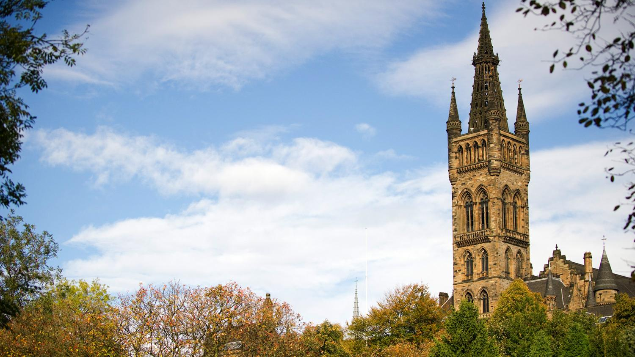



MSc Project Distributed Statistical Learning and Knowledge Diffusion in IoT Supervisor: Dr. Christos Anagnostopoulos
Kurt Portelli – 2222148p

Slide 2
Internet of Things (IoT)
Notes:
I’ll start of by explaining what the internet of things is ..

Slide 3
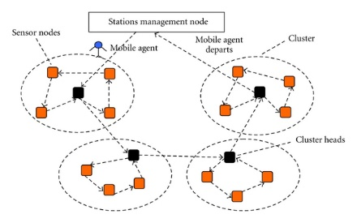
Internet of Things (IoT)
Everything is connected
Small chips/sensors
Computational capabilities
Make up large Sensor Networks
Generates massive amounts of data
Notes:
Well …
The idea is that everyday objects are connected to the internet
This is only possible due to processing chips becoming smaller.
This includes sensors capable of gathering information about their surroundings
Such networks can be made up of a large amount of devices in different locations.
Data is continuously read and transmitted to a central place/ concentrator

Slide 4
Real-Life scenario
Notes:
Let’s take a look at an existing real life scenario

Slide 5
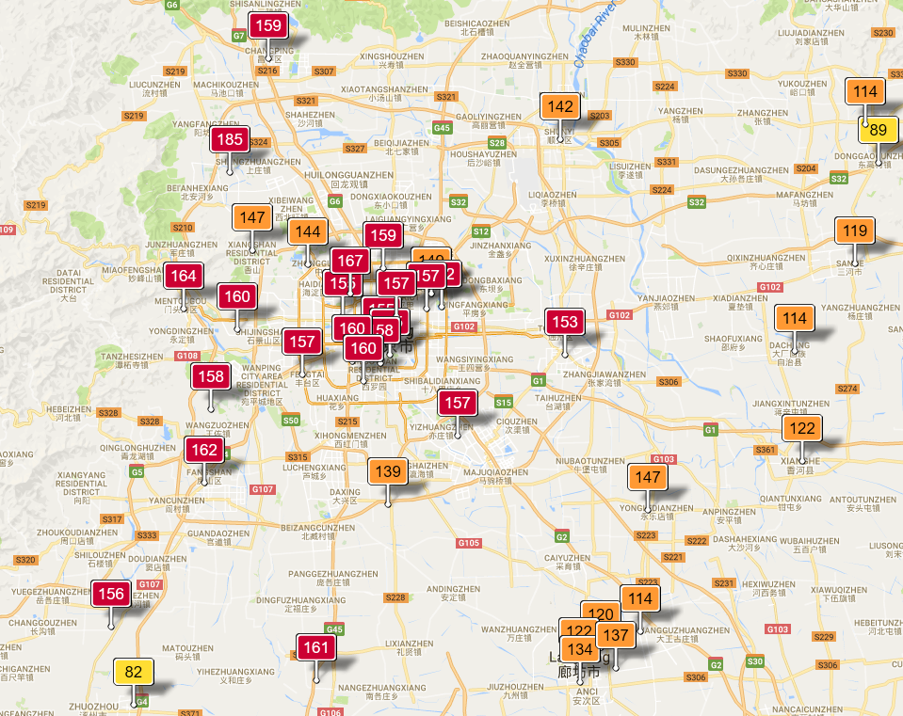
Air Pollution in Beijing
Notes:
These are existing stations in different location across Beijing.
They continuously gather data about the weather/ temperature/ pollutants / NO2
In our evaluation we used the full data set made up of 36 sensors.

Slide 6
Problem Definition
Notes:
So, what is exactly the problem we are tackling

Slide 7
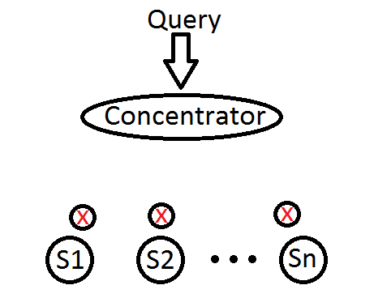
Problem
Network:
Large networks of sensors
Continuous stream of data
Power consumption
Data transmission
Data aggregation
Data Storage
Querying at central node:
Real-time restriction for environment monitoring
Notes:
Imagine thousands of sensors continuously transmitting information about their environment.
This leads to massive costs. Including; power costs, data transmission, storage
Another issue is that the information transmitted needs to be accessible in real time from the concentrator.

Slide 8
Aims
Notes:
Next, we will look at our aims.

Slide 9
Aims
A system capable of simulating an IoT environment.
For each sensor; Extract knowledge from raw data (Using statistical learning)
Leverage this knowledge to improve network efficiency.
Using ensemble learning, minimize the error at the concentrator.
Evaluate the query performance of the naïve approach and our system.
Notes:
Develop a system capable of simulating an IoT environment.
For each sensor, using statistical learning we want to extract knowledge from raw data
Using this knowledge we want to improve network efficiency.
Using ensemble learning we would like to minimize the error at the concentrator
Compare the naïve system and our system.

Slide 10
Contributions
Network Efficiency
Ensemble Learning
Notes:
We have 2 contributions in Network Efficiency and Ensemble Learning.

Slide 11
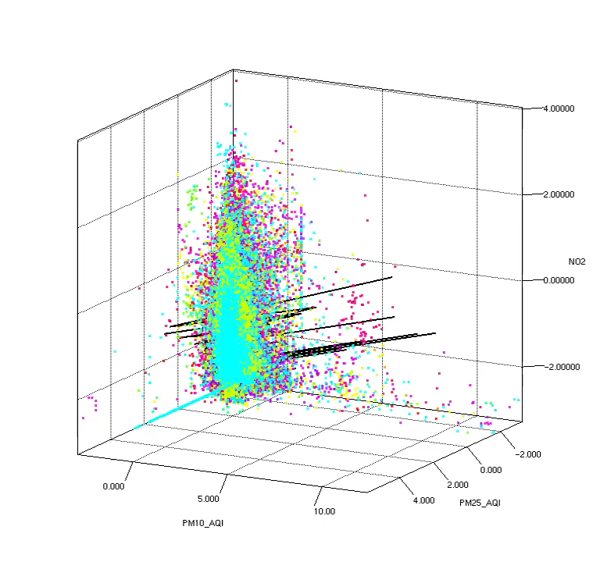
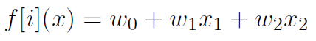
Online Stochastic Gradient Descent
Builds a relationship between the values
Creates the notion of knowledge
Measurable error in knowledge
Notes:
In our system we have a stream of data, so we have to extract knowledge using an online algorithm.
We use online stochastic gradient descent
The 3D graph on the right shows the Beijing Air Quality data.
Z-Axis represents air pollutants diameter 2.5, X-Axis – air pollutants diameter 1.0 and Y-Axis NO2
When new data arrives we update the weights of the function displayed.
The black line is the function that the system learnt from the 3D data points.

Slide 12
Network Efficiency - Theta
New Data
E = local error
E’ = Calculate concentrator error
E-E’ > THETA ?
Yes
Transmit model and keep a copy
Update local model and clustering
No
Notes:
This is the algorithm which determines the network efficiency.
When new data is read, we first update the local model using online stochastic gradient descent.
Then the cluster, using kmeans.
Afterwards we calculate the local error and concentrator error (since we store a copy)
Then we only send the new model if the difference in error is larger than a predefined THETA.

Slide 13
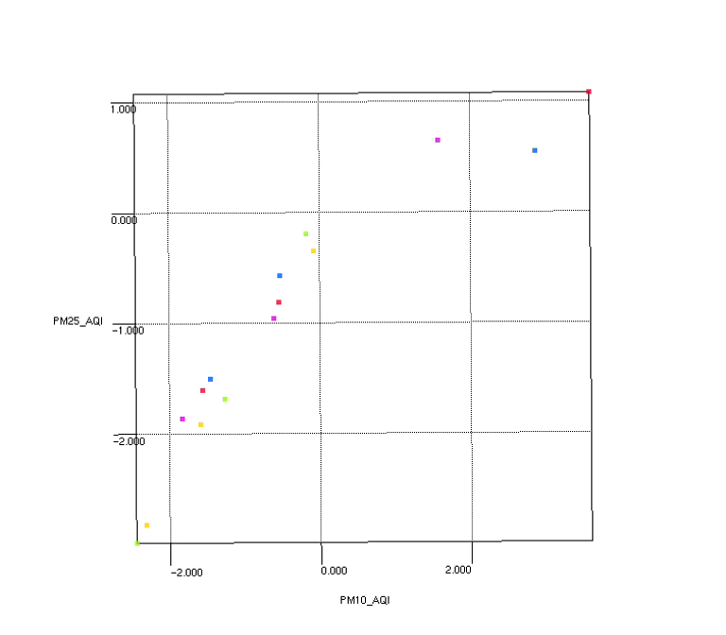
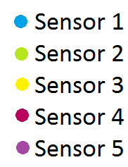
Ensemble Learning
Each sensor transmits data representatives
Concentrator stores all data representatives
Notes:
Along with the regression model we transmit data representatives.
For example this diagram represents the knowledge found in the concentrator.
We can see 3 data representatives for each sensor.
This would help the concentrator choose the ideal functions to use when a query arrives.

Slide 14
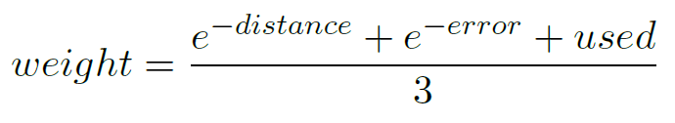
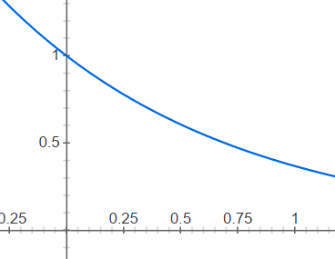
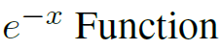
Reliability Function
With each cluster we associate an error and number of times used.
Note: all values are normalized
Notes:
When a query is issued to the concentrator the system evaluates which are the best functions to use.
This is done using the information contained in the data representatives.
As shown in the function displayed we use the Distance from query, error associated with cluster, number of times used.

Slide 15
Findings
Network efficiency study
Query accuracy
Notes:
I will now explain our findings.

Slide 16
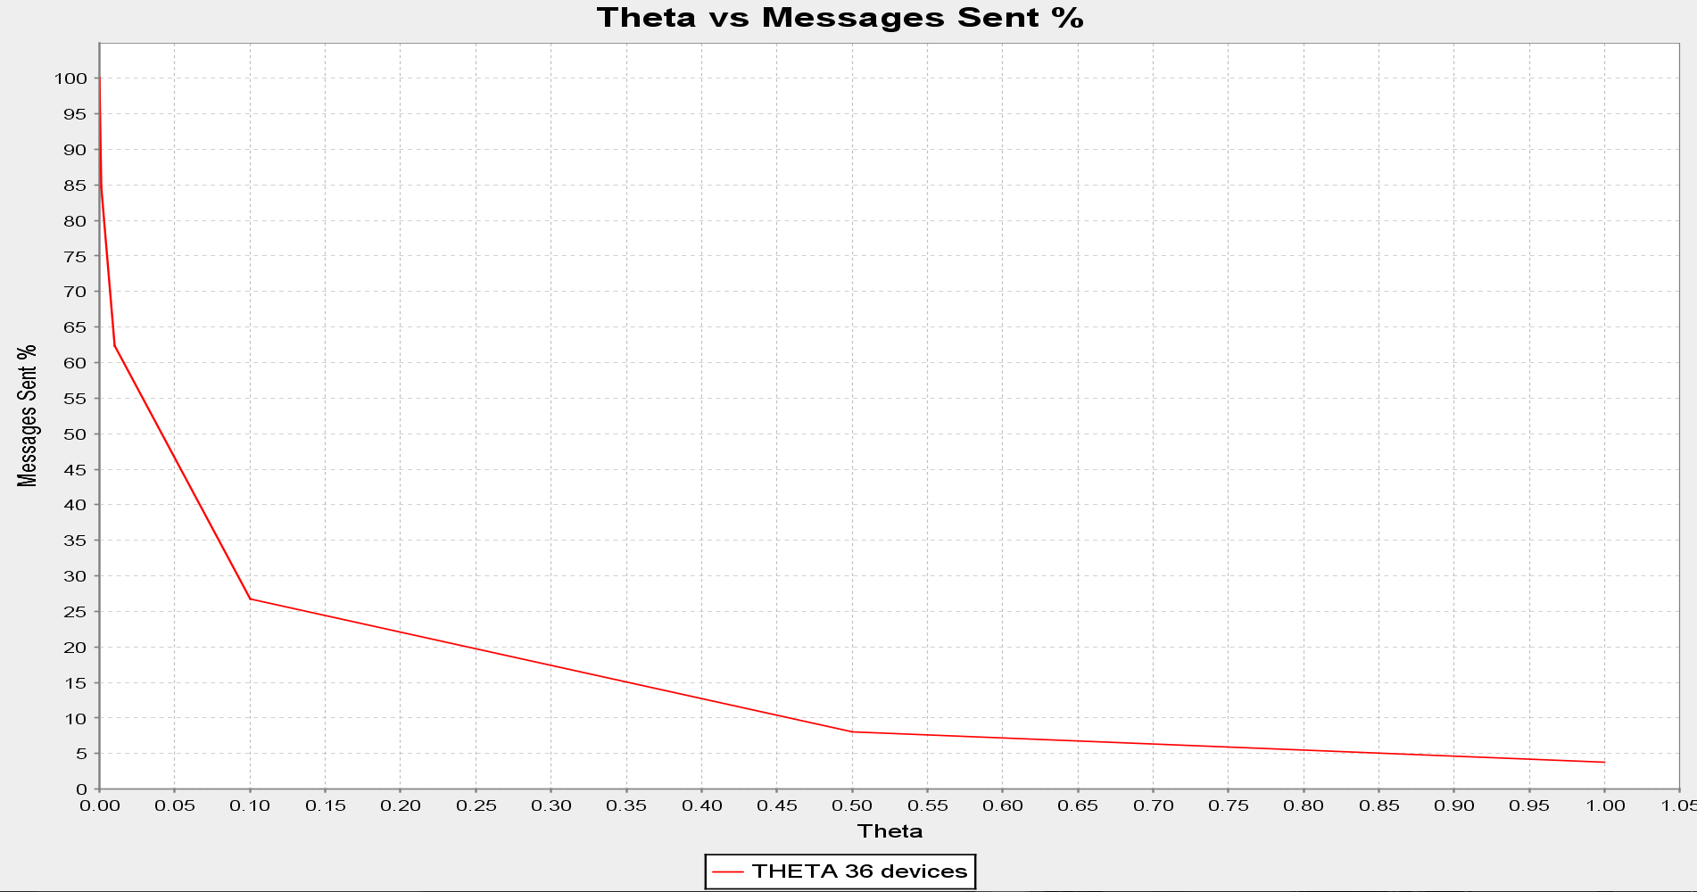
Theta vs Messages sent %
Notes:
This graph shows the THETA vs Messages Sent. Example at THETA 0 -100% of the messages are sent and at THETA 0.5 – 10% of the messages are sent.

Slide 17
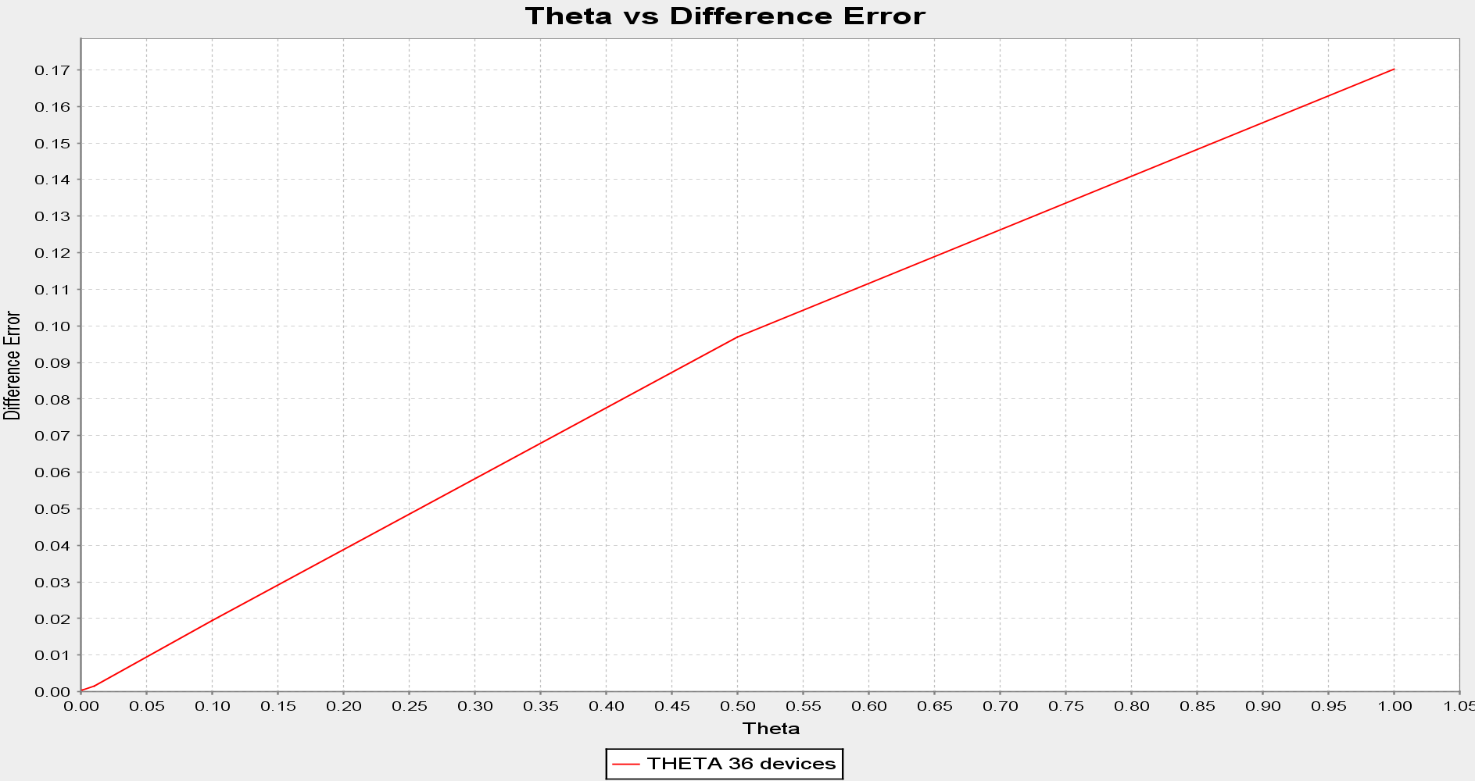
Theta vs Difference Error
Notes:
THETA represents how strict the system is towards updating the model at the concentrator. As one can see the large THETA is the larger the error.

Slide 18
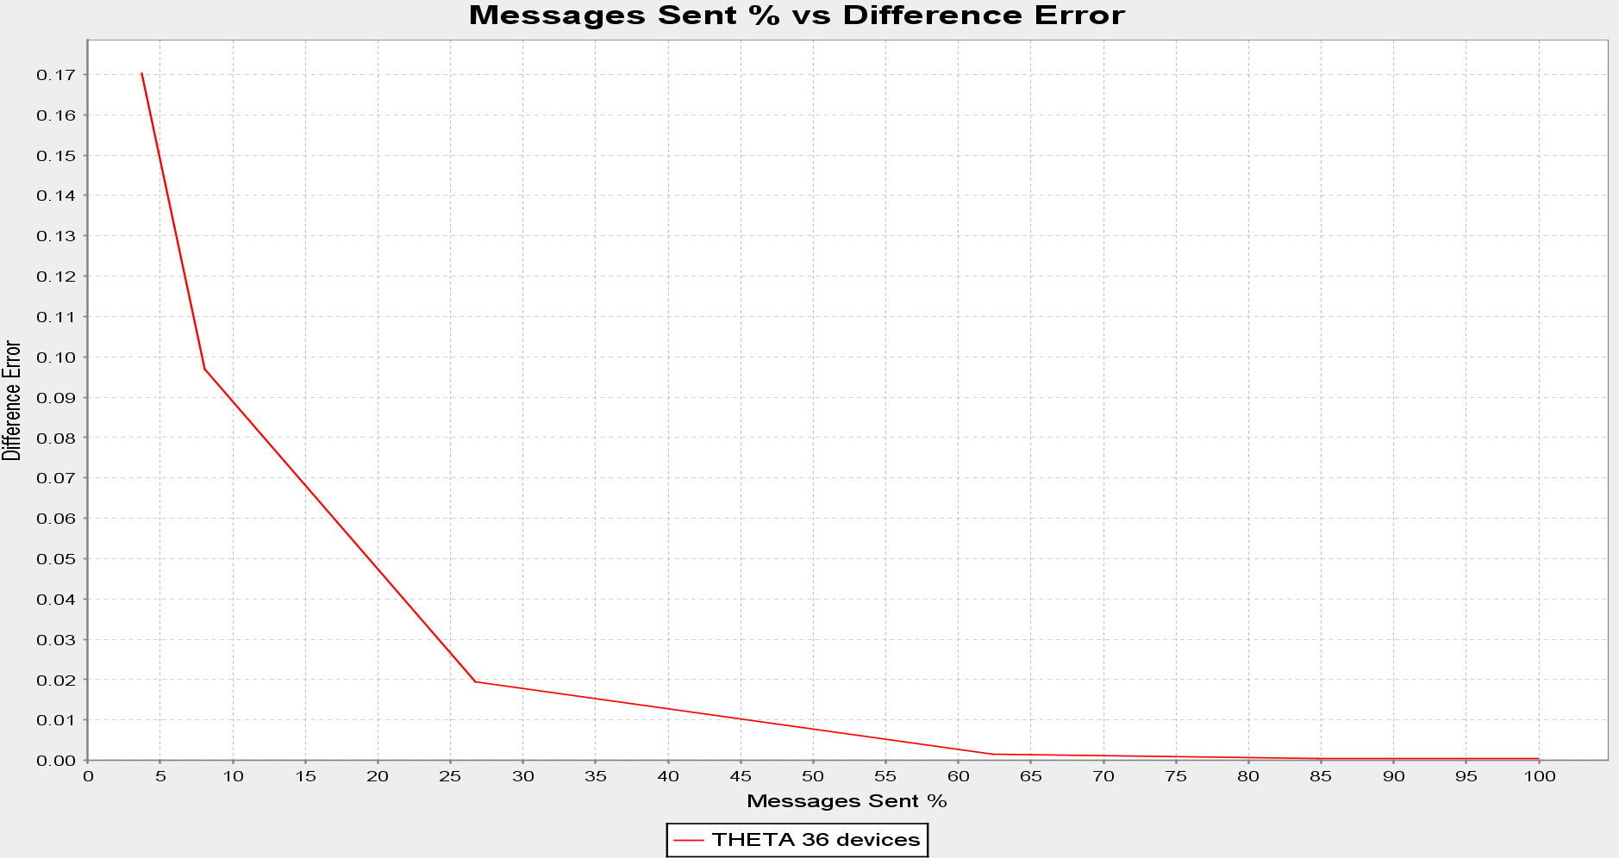
Messages Sent % vs Difference Error
Notes:
Joining the 2 graphs together by removing THETA we can see the relationship between messages sent and difference in error.
An interesting thing is for example sending just 60% of messages has barely any effect on the overall error.
Meaning that 40% of the messages had no new knowledge.

Slide 19
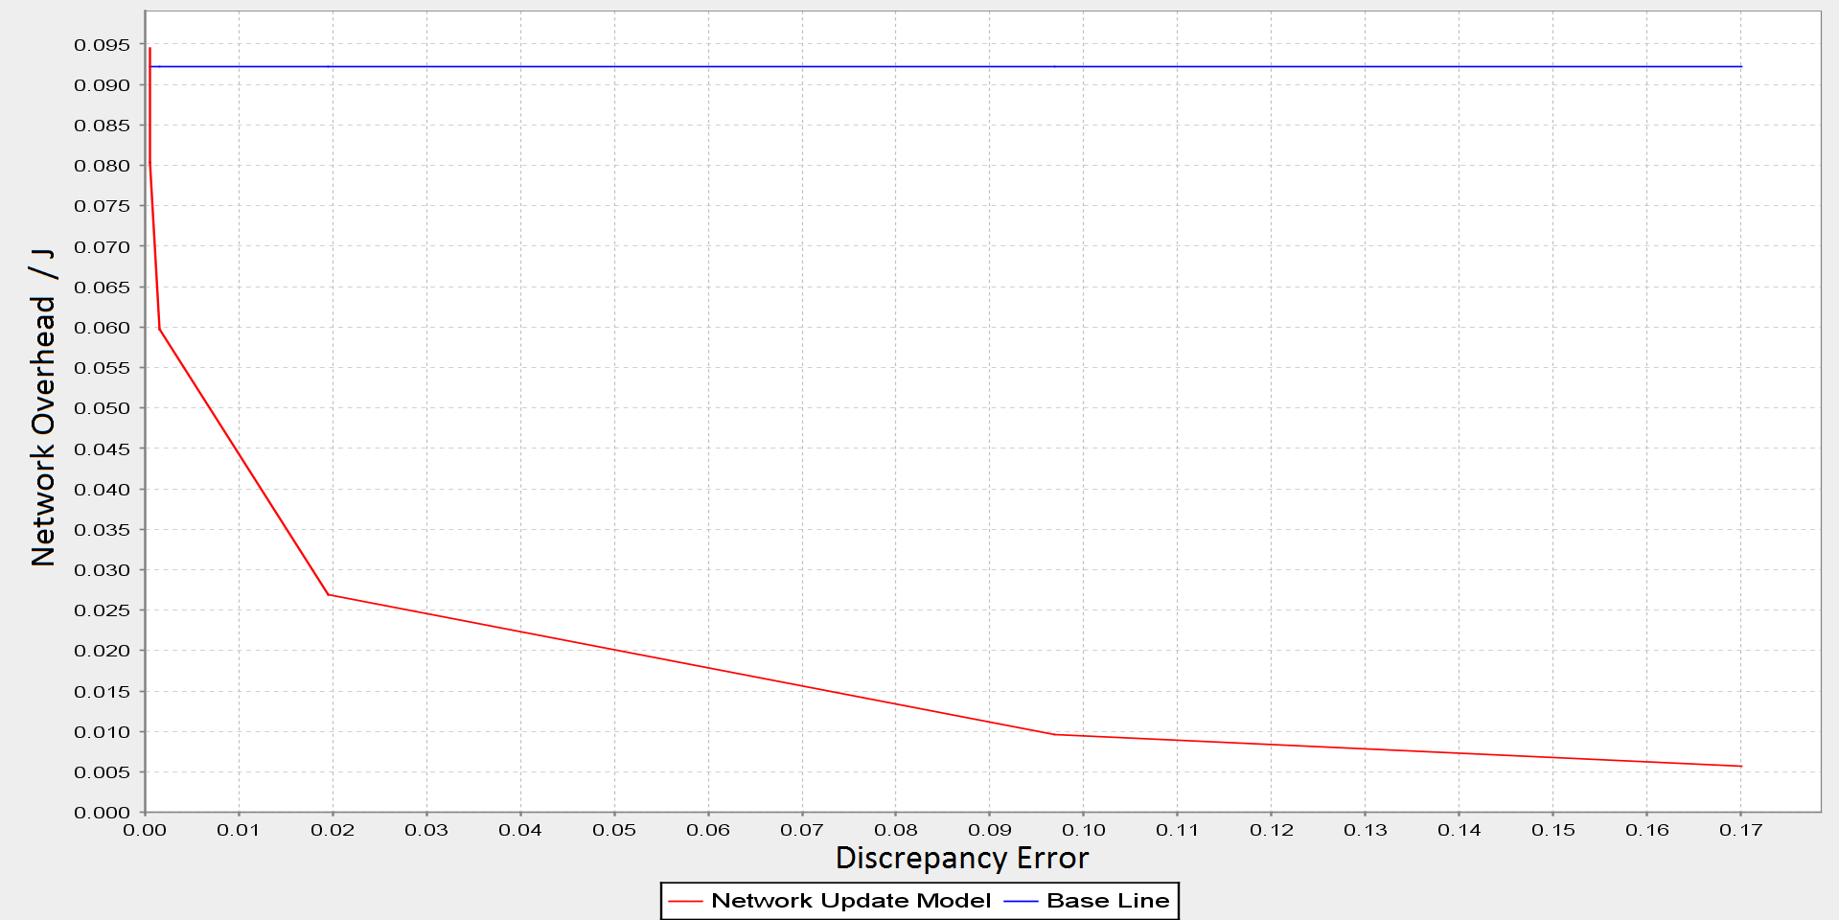
Network Overhead / J vs Error
Notes:
Taking into consideration transmission and computation energy costs we are able to plot this graph
Which shows the actual network overhead for the naïve approach which sends all the data vs
our system. The more lenient we are on the error the more energy we can save.

Slide 20
Query Accuracy algorithms
Baseline – transmit all raw data
Ideal – knowledge from the correct sensor
Average – knowledge from all sensors
Distance – small subset of knowledge based on distance
Reliability – small subset of knowledge based on weight
Notes:
Before I explained the evaluation for efficient network transfer.
Now I shall explain the evaluation of the query accuracy at the concentrator.
The Baseline is the naïve model which transmits all the raw data.
The Ideal is when we use only the knowledge from the correct sensor.
Average is when we average all the functions
Distance is the one which uses a subset of the functions based on the distance from the query
And finally Reliability uses a subset of the functions sorted according to the highest weight.

Slide 21
Query Accuracy – Theta 0.001
84.7% messages sent
Notes:
This is the Query Accuracy for THETA 0.001 – 84.7% messages
From the 3D plot we can see that we should try to approach the Baseline.
The average solution provides better results than the ideal suggesting there is a subset of functions better than the average.
At higher KNN the Reliability algorithm provides better results than the average.

Slide 22
Query Accuracy – Theta 0.1
26.7% messages sent
Notes:
We can see the same things at a higher THETA.

Slide 23
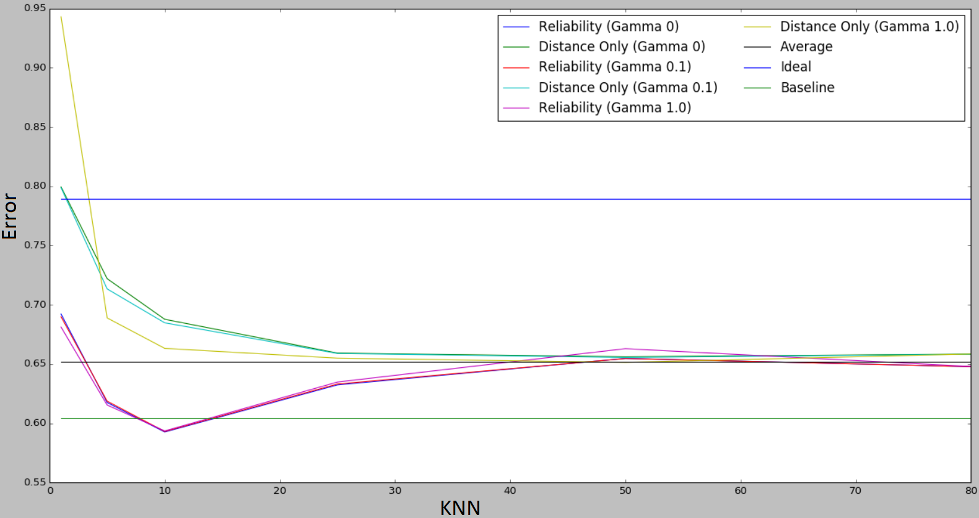
Gamma vs Accuracy
Notes:
We now introduce GAMMA which defines the frequency of the cluster updates.
The cluster messages drastically increase power consumption due to their increase in size thus cannot be sent frequently.
This graph shows the error of different GAMMA settings.
We can see that the frequency of cluster updates does not impact the accuracy error of the reliability algorithm.

Slide 24
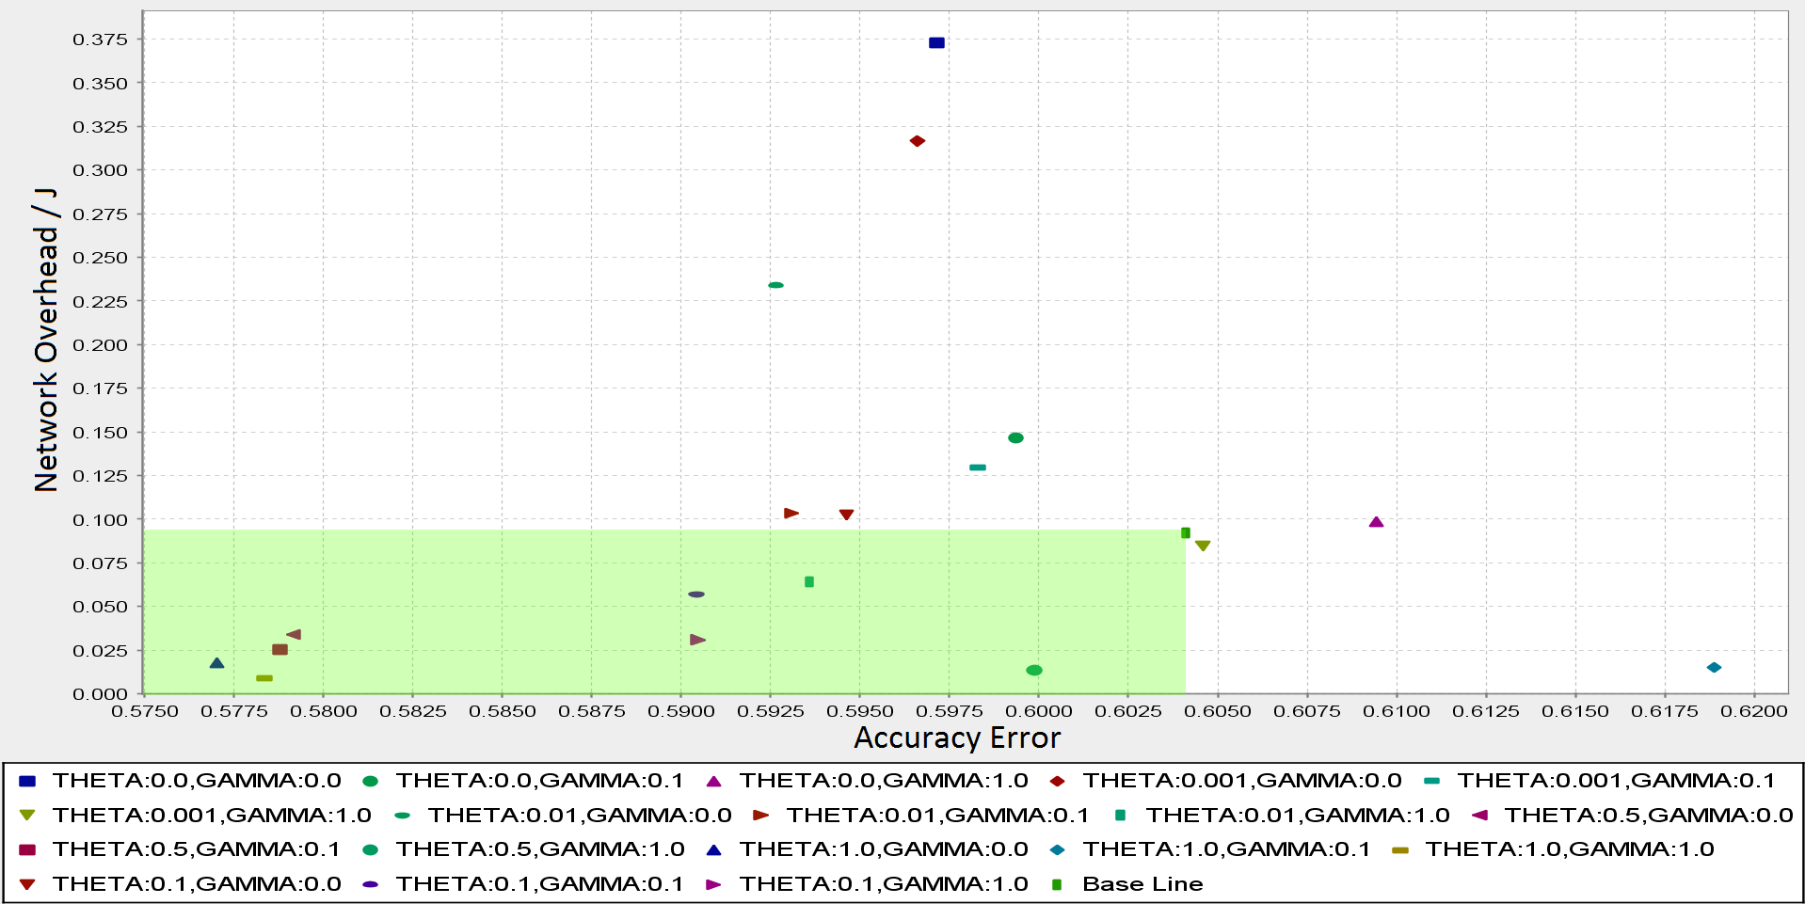
Network Overhead / J vs Accuracy Error
Notes:
This plot shows the network overhead of the different settings when using the reliability algorithm.
Here we can see the Baseline network overhead and accuracy error.
The Green overlay shows the settings which are more accurate while using less energy than the baseline.

Slide 25
Conclusion
Notes:
Now .. to conclude,

Slide 26
Conclusion
We have a system that:
Simulates an IoT environment
Extracts knowledge from raw data
Decides it is worth it to transmit the new knowledge.
Intelligently Quantizes the input space
Notes:
We have a system that simulates an IoT environment
Extracts knowledge from raw data using statistical learning
Evaluates the contribution of the new knowledge.
And only transmits it if it is useful.
It also intelligently quantizes the input space.. Based on distance, error, usage.
To maximise query accuracy.

Slide 27
Thank you
Questions:
k.portelli.1@research.gla.ac.uk
Notes:
Thank you for your time
This was just a brief summary but you can find all the details in the thesis itself, link in the description below.
Any questions don’t hesitate to email me.

